Slide 1
Solution Presentation
2022 ITU GeoAI Location Mention Recognition Challenge Finale
TEAM INGENUITY

Slide 2
Outline
Introduction
Problem
Methodology
Evaluation & Results
Way Forward

Slide 3
Introduction

Slide 4
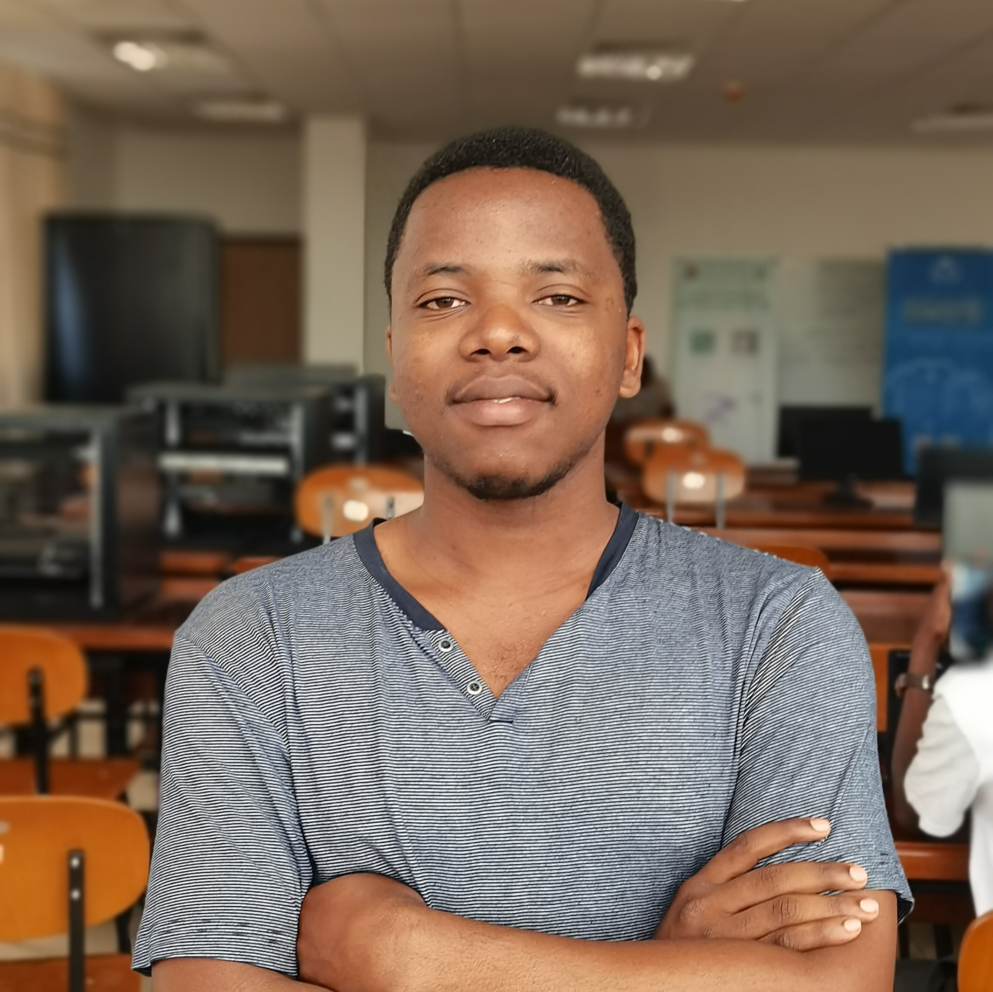
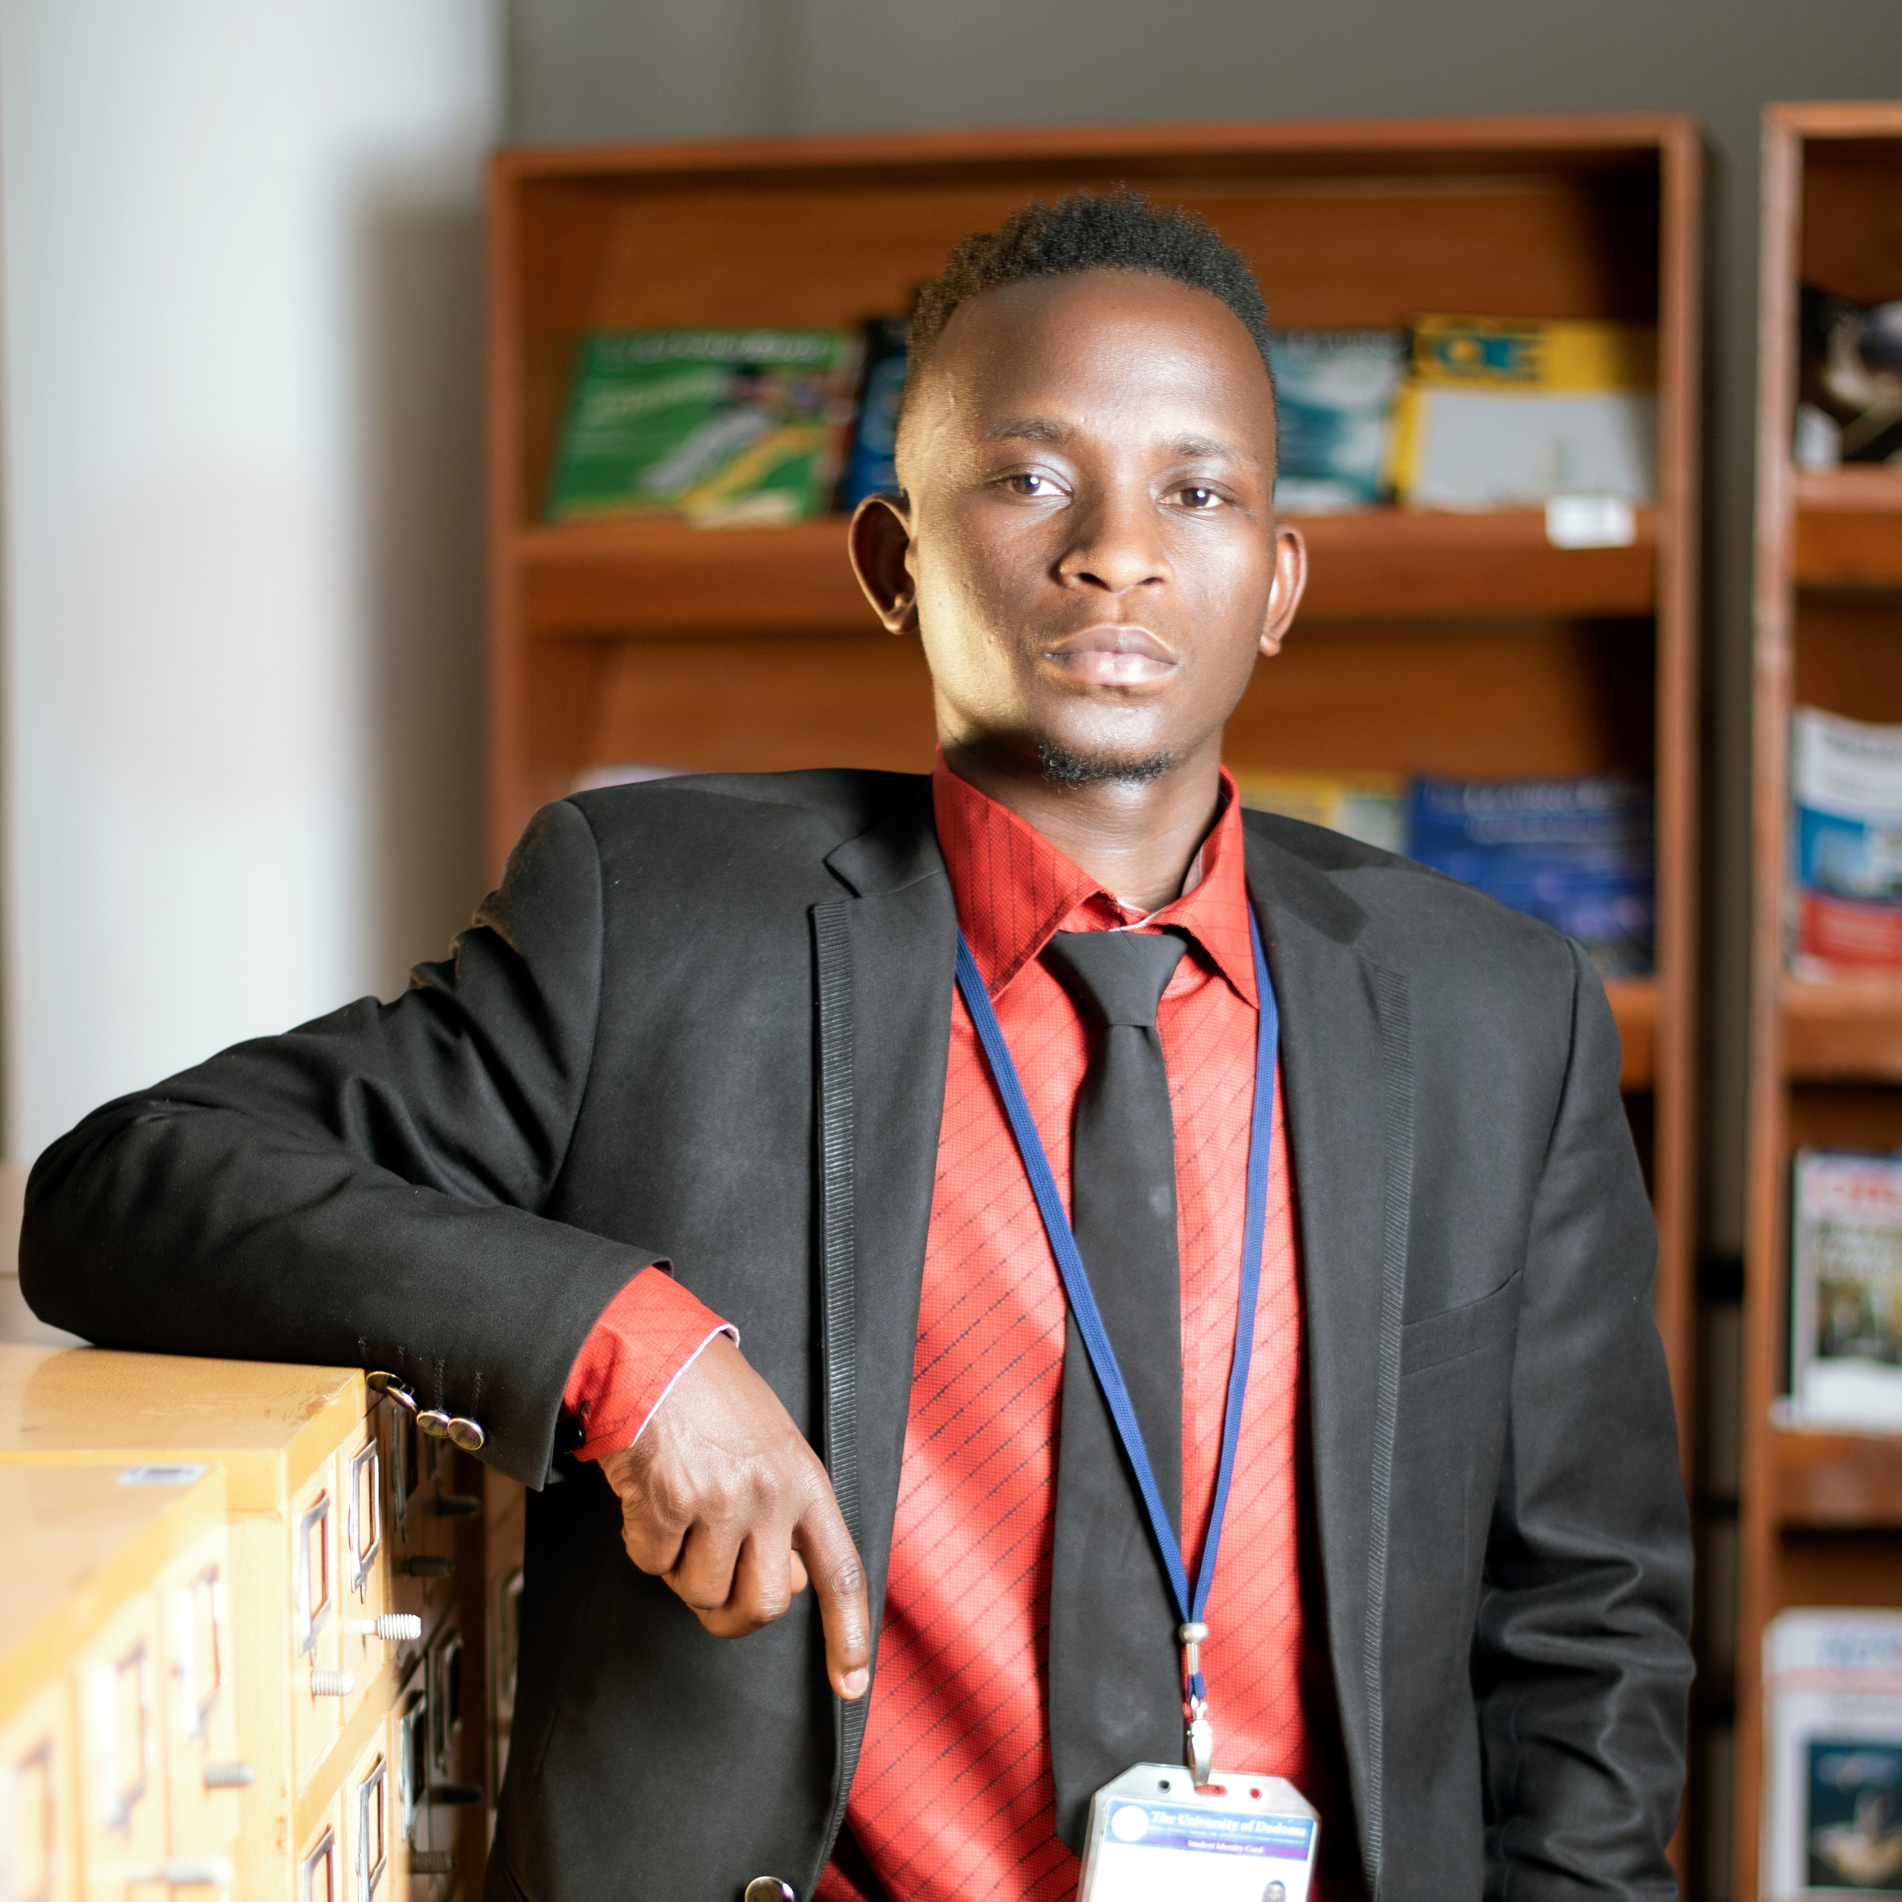
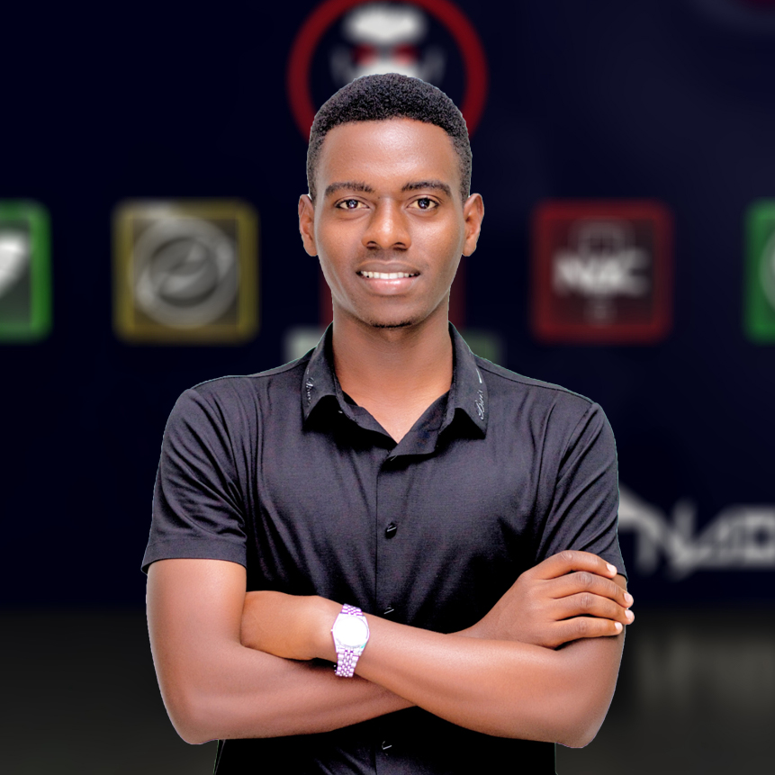
TEAM INGENUITY
THE UNIVERSITY OF DODOMA – TANZANIA
4th Years BSc. Software Engineering
Bright Augustino
Innocent Charles
Ndabuye S. Gideon
Expertise
AI & ML
Block Chain
Expertise
AI & ML
Software Engineering
Expertise
AI/ML and Analytics
Cloud Solutions

Slide 5
Motivation for Participation
Chance to work on a very challenging problem that has a real-world application.
Potential to gain recognition and advance our careers by demonstrating our expertise.

Slide 6
Problem
Source: ITU AI Challenge

Slide 7
Location Mention Recognition from Social Media - Crisis
During disasters, Twitter messages carry critical information which can be helpful in various ways.
Locating of the disasters for respective authorities is one of them.
But due to high volume of tweets, manual extraction of locations is impractical.

Slide 8
Objective

Slide 9
Location Mention Recognition (LMR) System
Development of automated system for Location Mention Recognition (LMR) from a stream of tweets during emergencies.
The automatic system is anticipated to support the relief activities that are executed by response authorities during disasters.

Slide 10
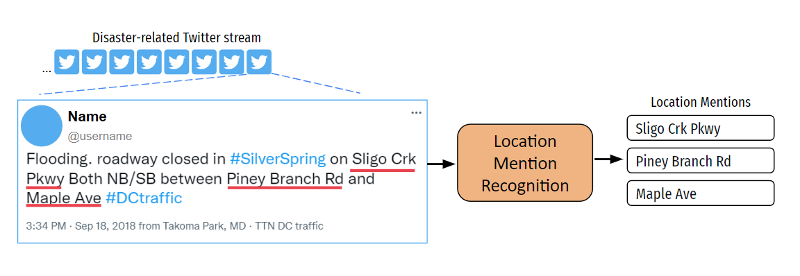
Location Mention Recognition (LMR) Diagrammatically

Slide 11
Methodology

Slide 12
Implementation Details
Spacy NLP library (Python)
We used Spacy NLP tok2vec NER pipeline to build our model which requires data to be in spacy format.
Input data
The IDRISI Dataset (Gold-random-json). Which totaled to around 13000 tweets.

Slide 13
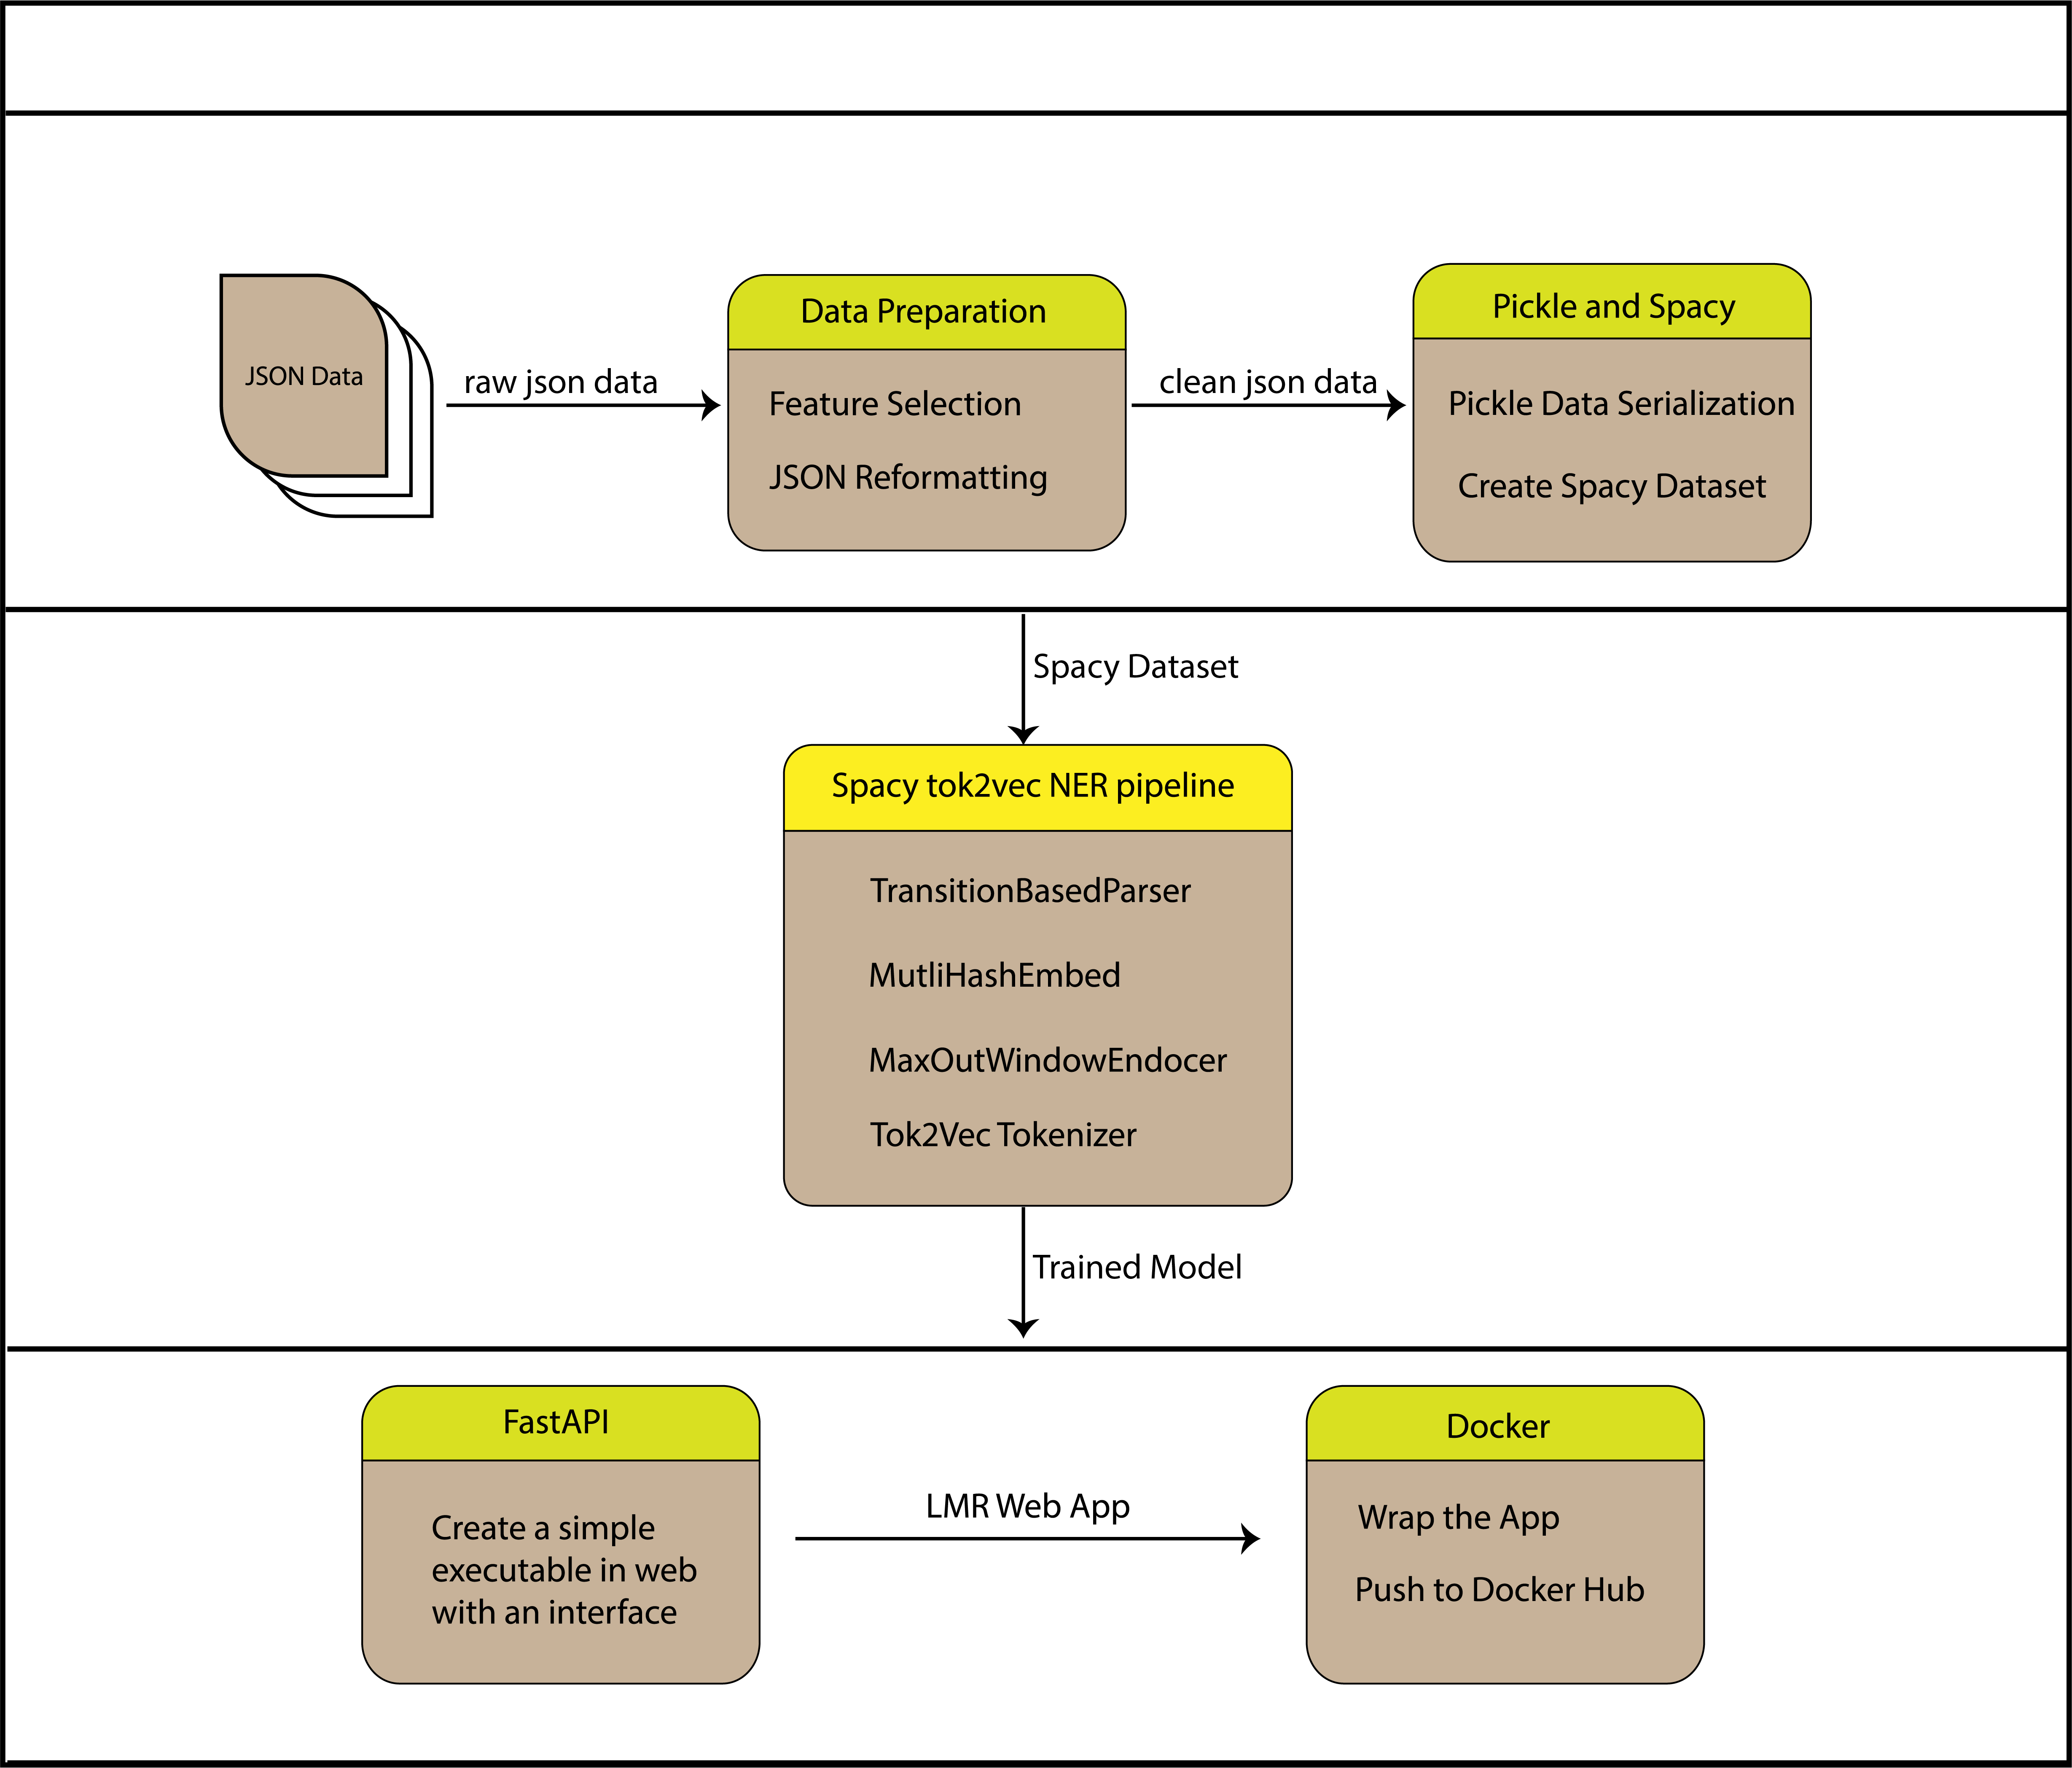
Solution HL Architecture
Data preparation & preprocessing
Modelling
Deployment

Slide 14
Evaluation & Results

Slide 15
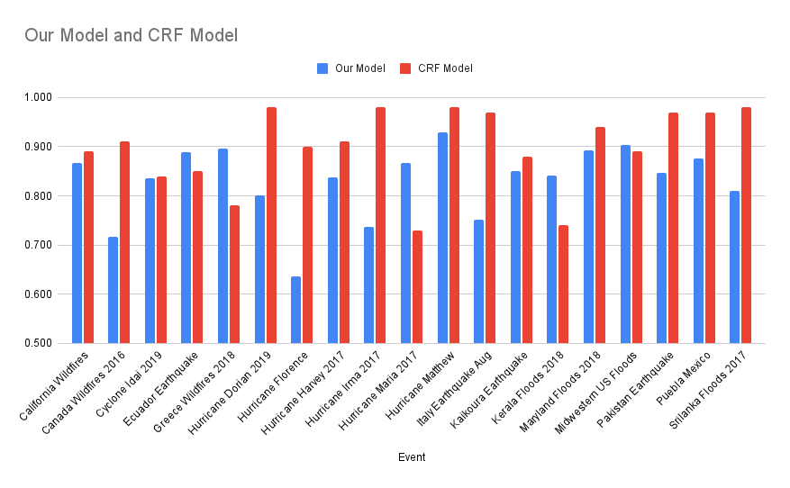
Model Performance Per Event: Type-less

Slide 16
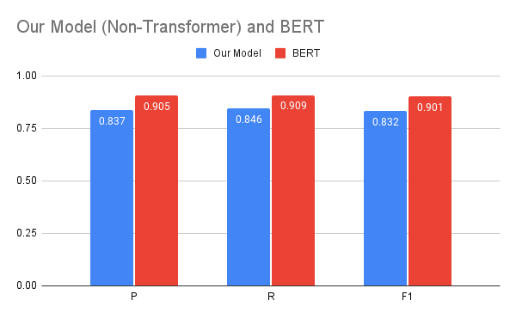
Results – Overall Performance Comparison So Far

Slide 17
Way Forward
Increase model performance. With various techniques,
Text Augmentation
Model Fine Tuning
Make the solution available to public for testing in web interface and API for developers.

Slide 18
Thank you
Team Contacts
Bright Augustino
+255 682 868 891
augustinobright@gmail.com
Innocent Charles
+255 738 095 412
innocentcharles217@gmail.com
Ndabuye S. Gideon
+255 657 896 922
sndabuye@gmail.com

